Slide 1
Super Astro Thief
Team : WhiteWalkers
Elif Hepateskan, Garret King, Samuel Meyerding, Ryan Vichitthavong

Slide 2
Game Overview
Single player stealth game
2D Top-Down and 2D Side Scrolling
Spaceship levels
Character levels

Slide 3
Story
You’re the Most Wanted Space Thief in the sector and your luck has just run out
You’ve been captured and placed in Space Prison.
You must escape, repair a ship, and flee to the next sector to retire to a life of crime.

Slide 4
General Mechanics
Avoid enemy line of sight
Switch between 2D side-scroller and 2D top-down stealth
Operate switches and buttons to open paths.
Distract Guards to change their patrol paths.
Collect level specific items
Traverse from point A to point B and escape.
Restricted Sight

Slide 5
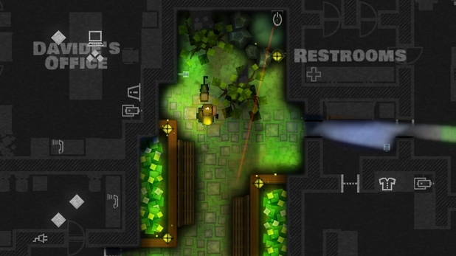
Similar Games
R-Type
Metal Gear
Monaco
Notes:
Image Source: Screenshot from Monaco found at https://videogamerrob.wordpress.com/2013/05/07/pcxbla-review-monaco-whats-yours-is-mine/

Slide 6
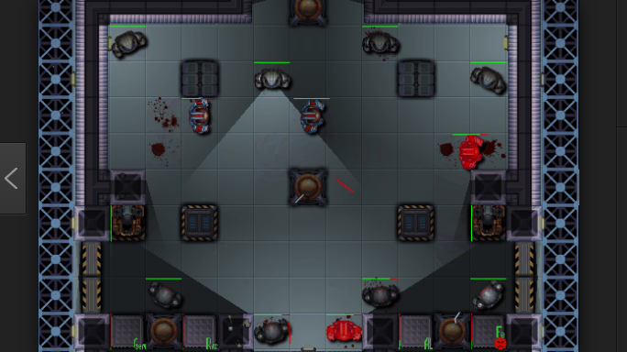
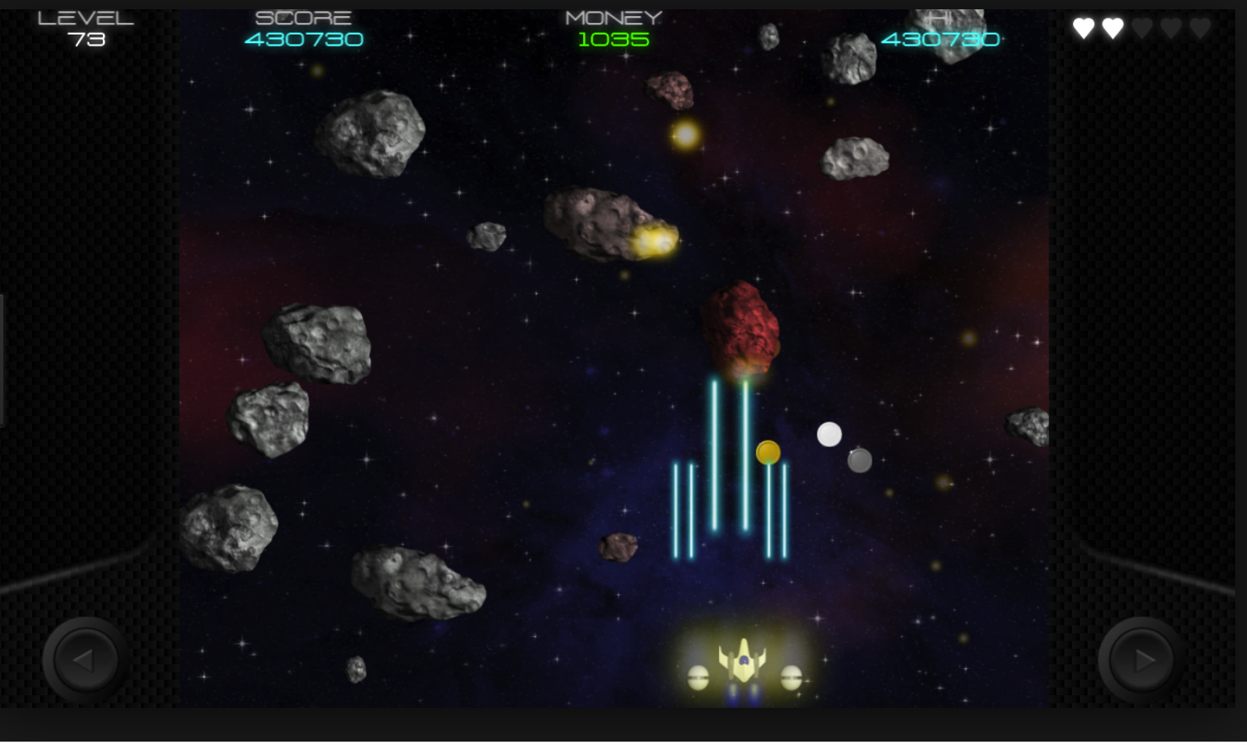
Similar Game UI Examples
Thief Inside The Ship
Thief in Space
Notes:
Reference:
“Thief Inside Ship”: https://theindiestone.com/forums/index.php?/profile/21416-alexmartial/
“Thief in space”: https://play.google.com/store/apps/details?id=com.jam.sectoids.full

Slide 7
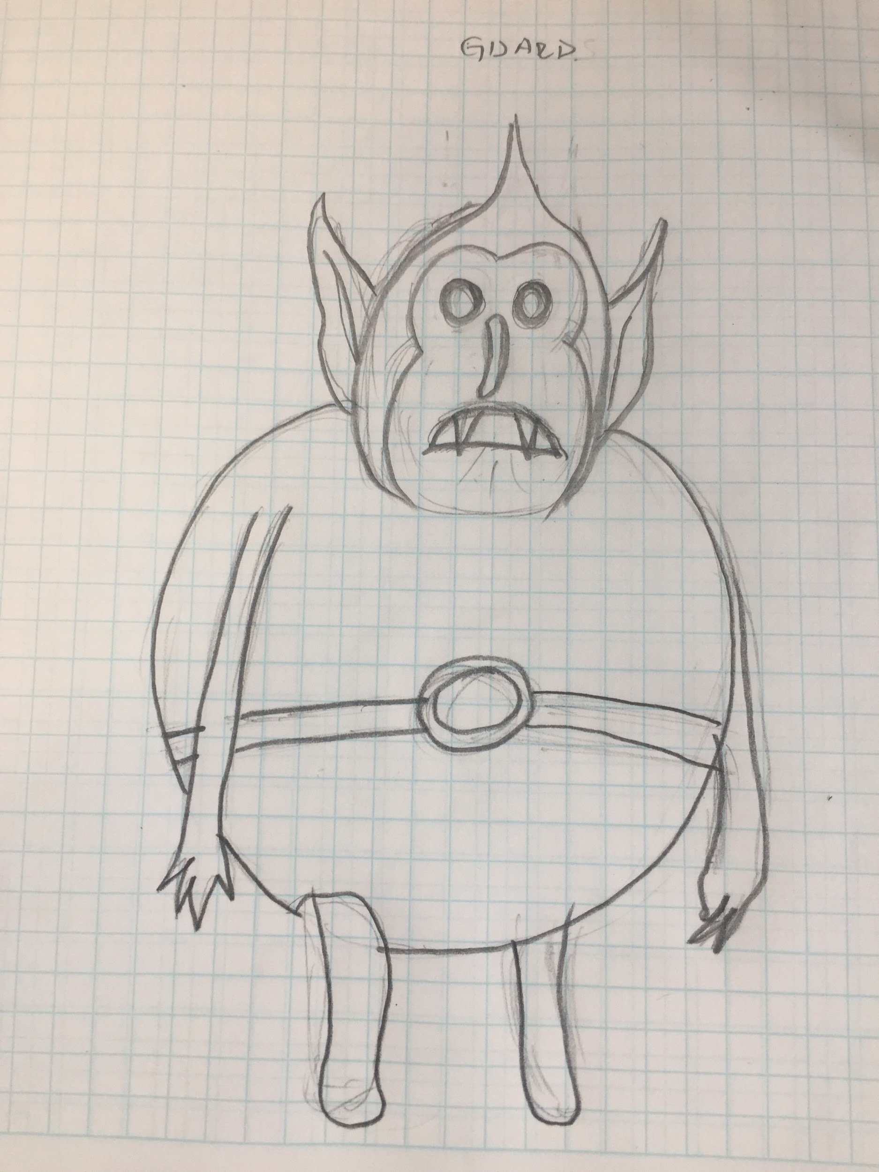
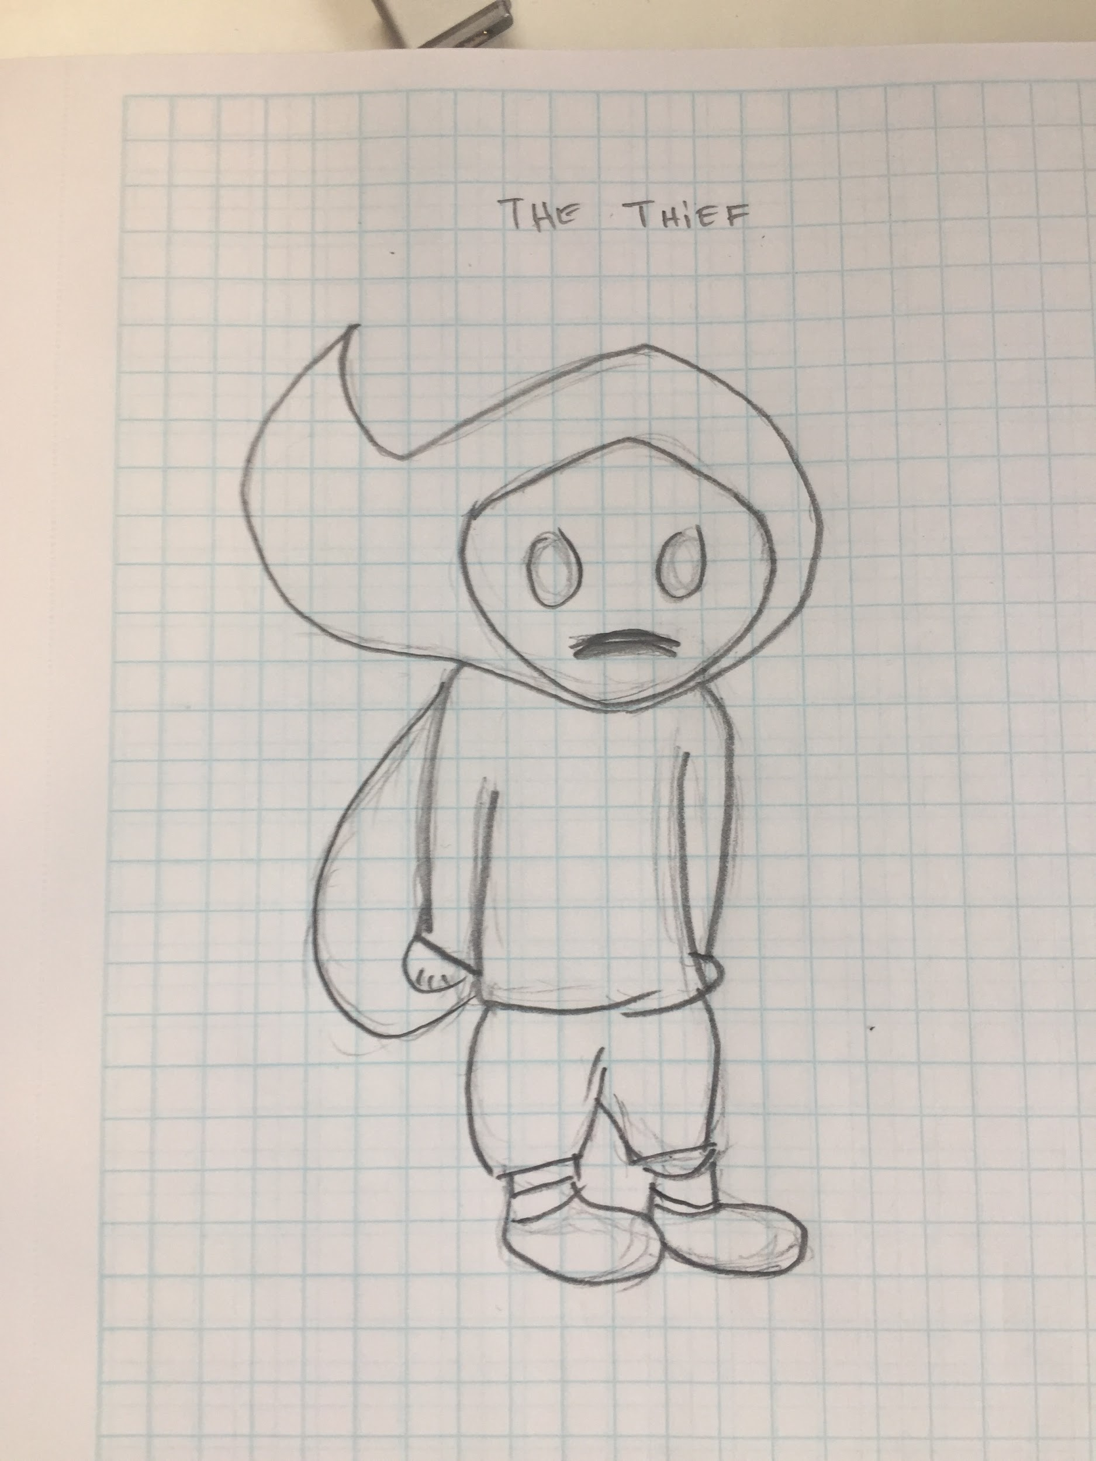
Concept Art

Slide 8
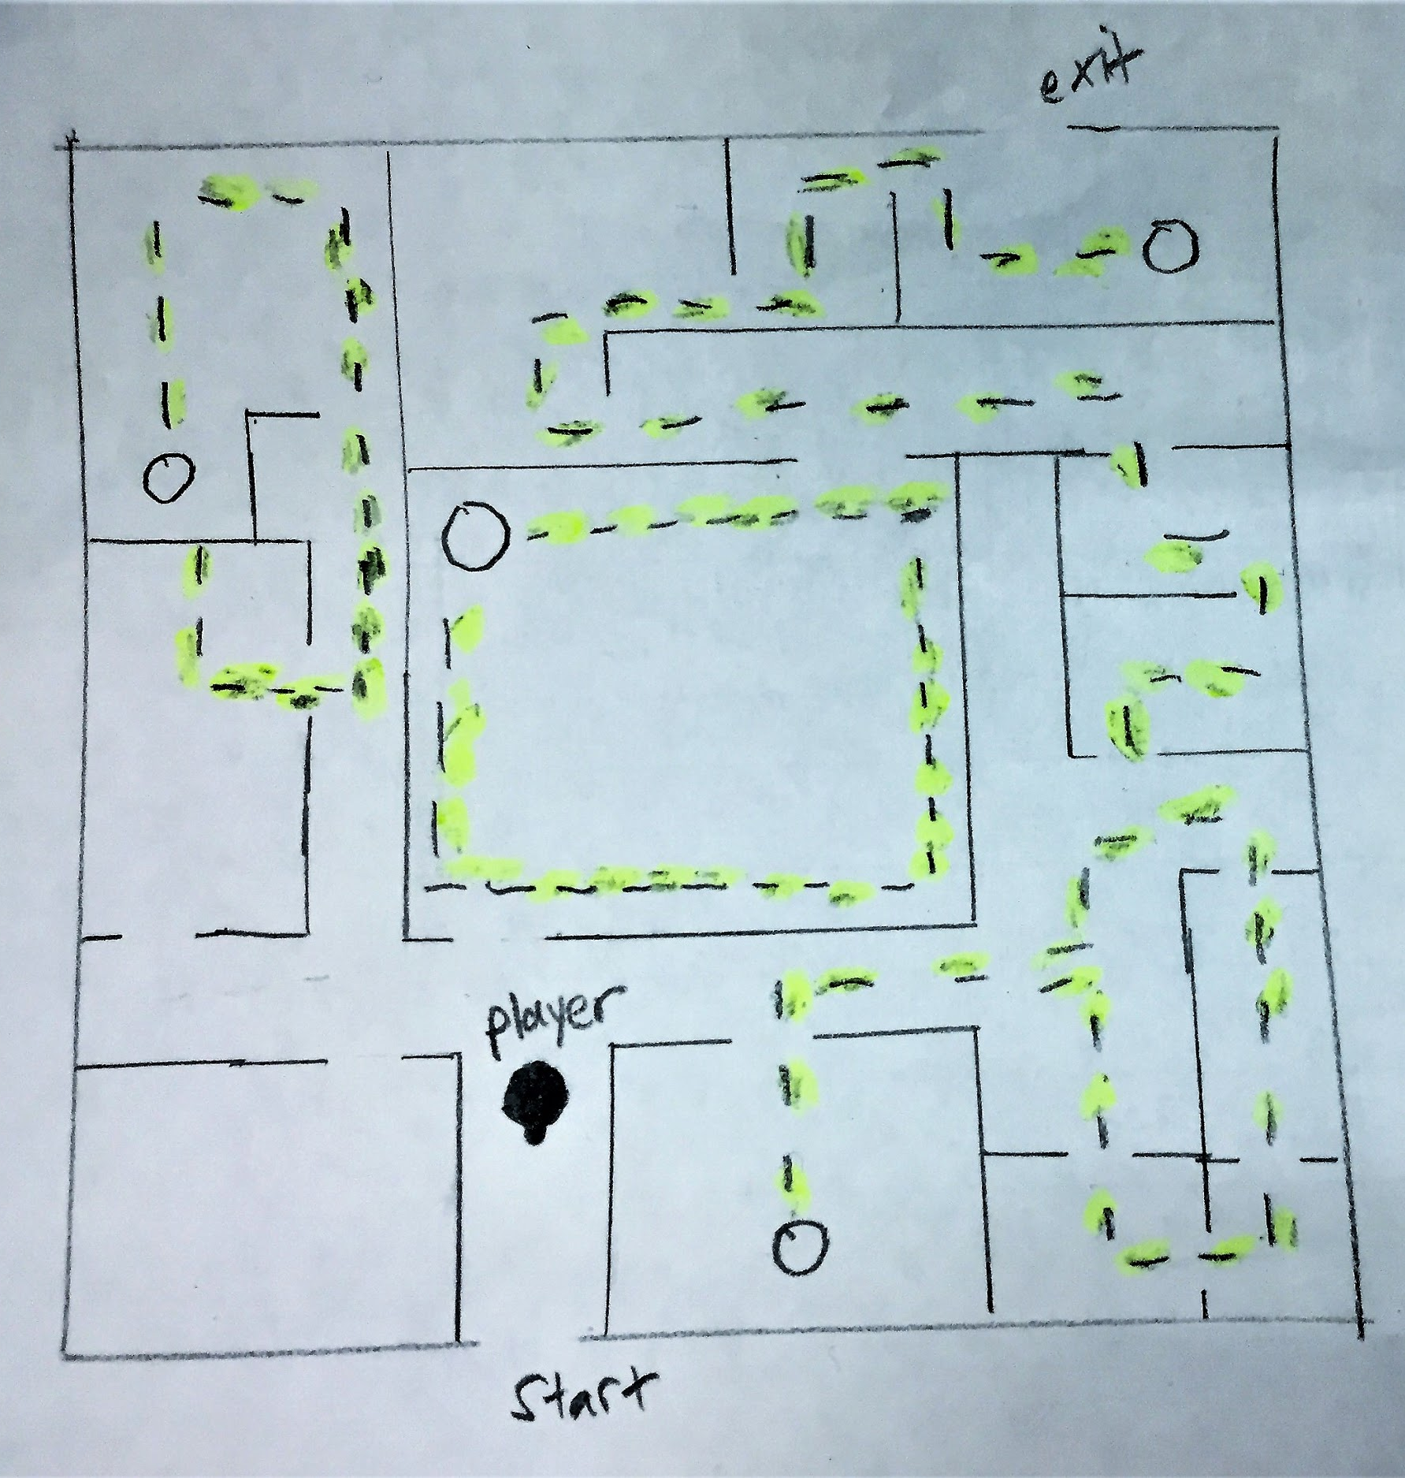
Concept Art

Slide 9
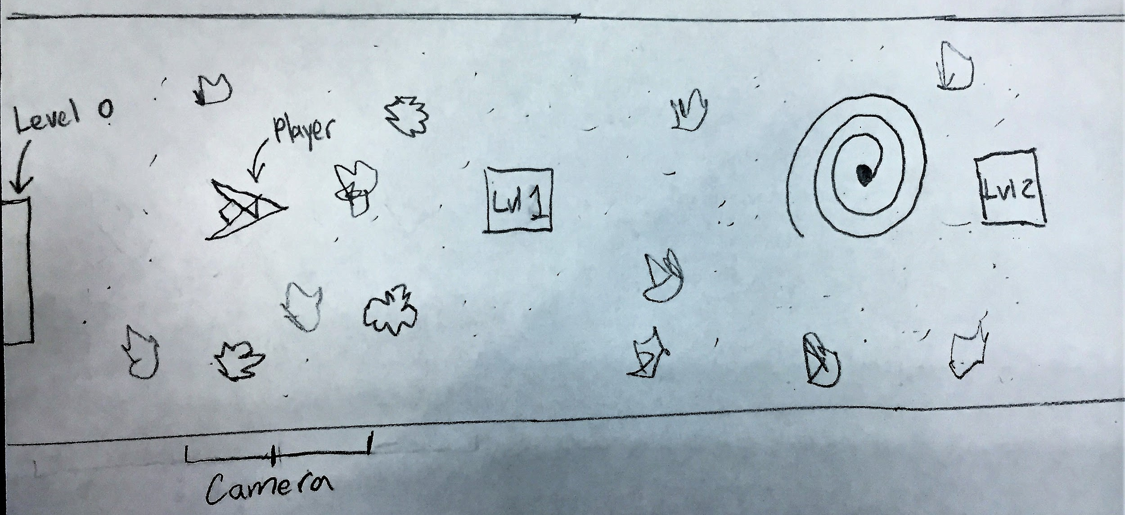
Concept Art

Slide 10
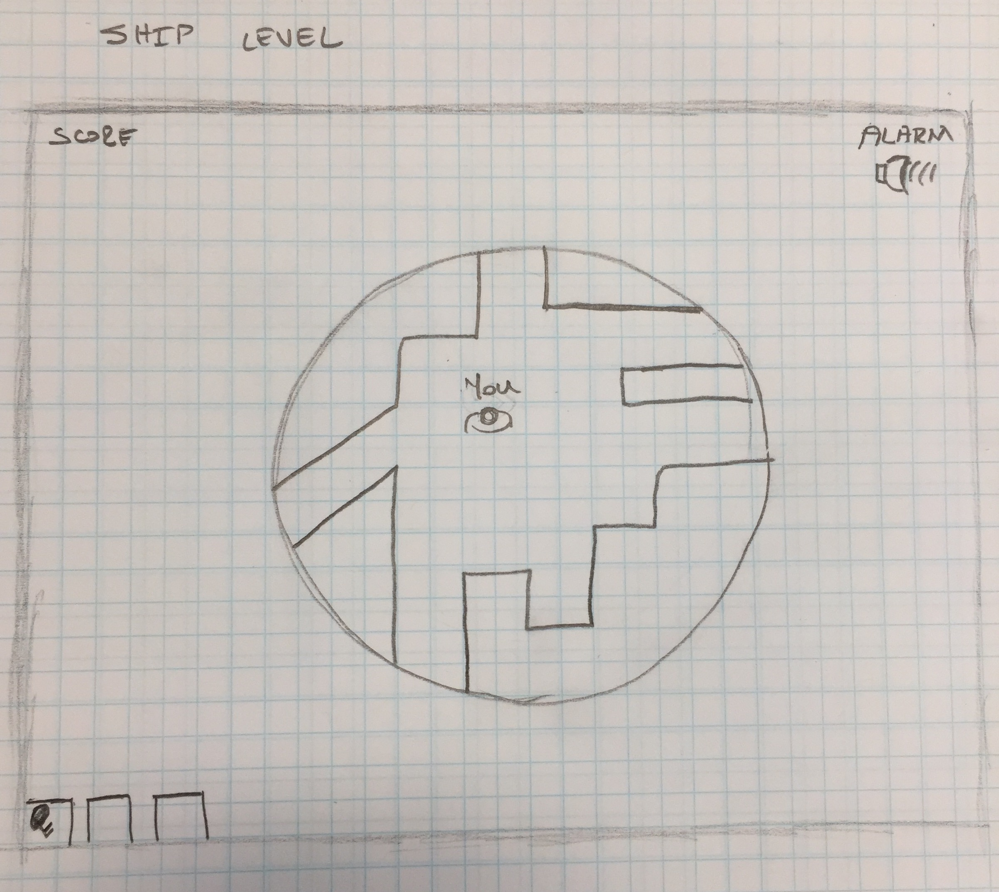
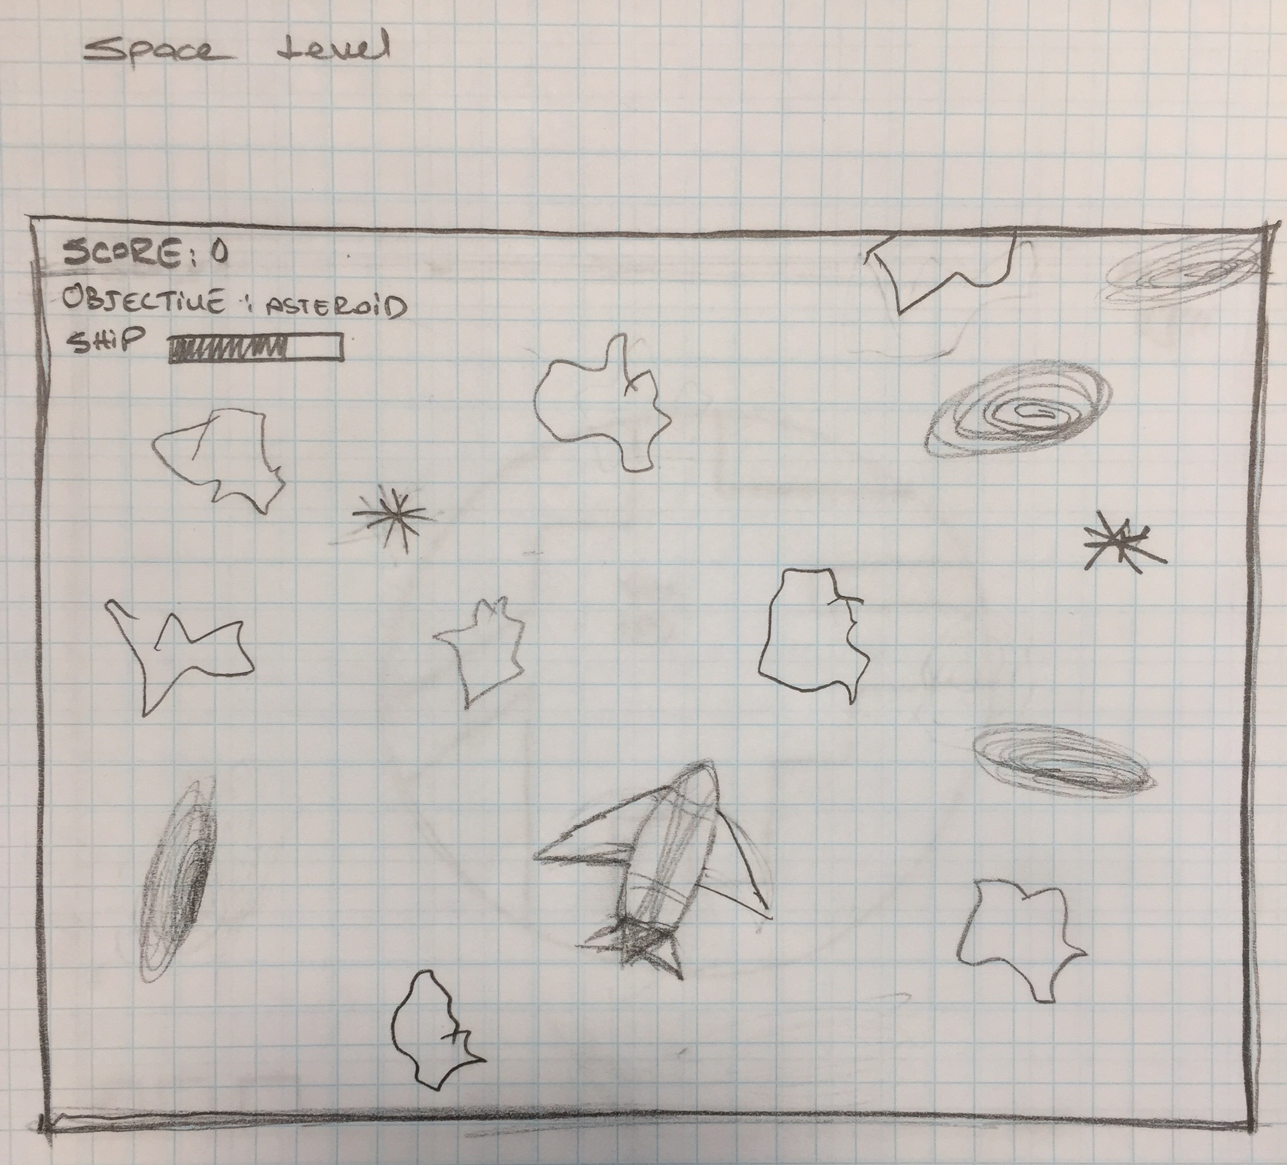
UI EXAMPLE

Slide 11
Victory Conditions
Level: Player manages to steal the target and escape with it.
Game: Player beats all of the levels necessary to escape to the next sector.

Slide 12
Consequences
Getting detected inside the spaceship level
Increase difficulty
Decrease score
Captured inside the spaceship level
Restart in space prison
Colliding with an obstacle in outer space
Lose ship health
Temporarily disables ship
Losing all of the ship health
Ship is disabled and captured
Restarts in space prison

Slide 13
Achievements and Upgrades
Levels have a completion rating
Temporary power-ups
Level completion results in improved user behavior

Slide 14
Expected difficulties
Guards behaviour
Pathing
Line of sight
2D Side scrolling
Top-down limited user sight
User power-ups (cloaking, lantern, speed boost)

Slide 15
Planned Prototypes
Guards pathing
Guard line of sight and state change
Ship with 2D side scrolling
Restricting user vision/line of sight
User power-ups

Slide 16
Potential Features
Advanced Line-of-Sight Lighting
Difficulty Modes
More Levels
More Unique Obstacles
Permanent Upgrades

